Slide 1
Digital wallet
e

Slide 2
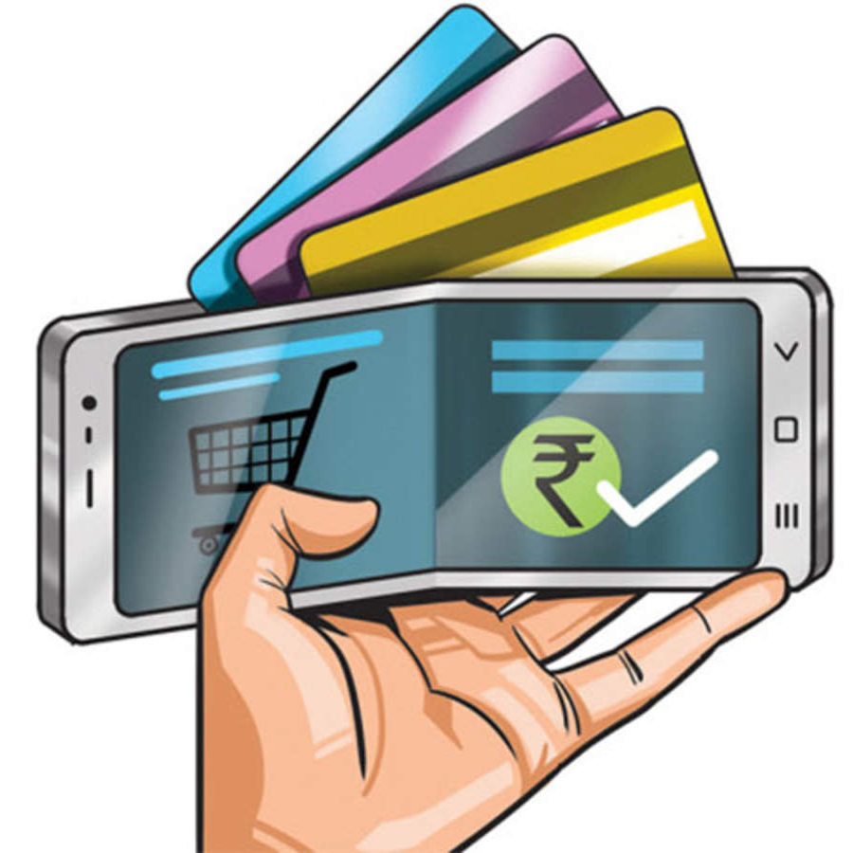
Agenda
Improving access to financial services in underserved area
To end the carrying a physical wallet and cards
* Giving users a secured money storage and transfer

Slide 3
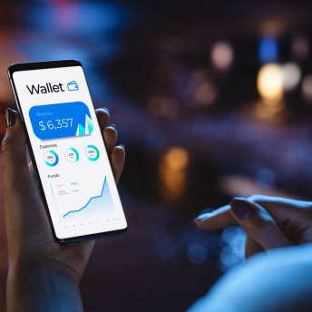
Introduction
A digital wallet (or electronic wallet) is a financial transaction application that runs on any connected device. It securely stores your payment information and passwords in the cloud. Digital wallets may be accessible from a computer; mobile wallets, which are a subset, are primarily used on mobile devices.

Slide 4
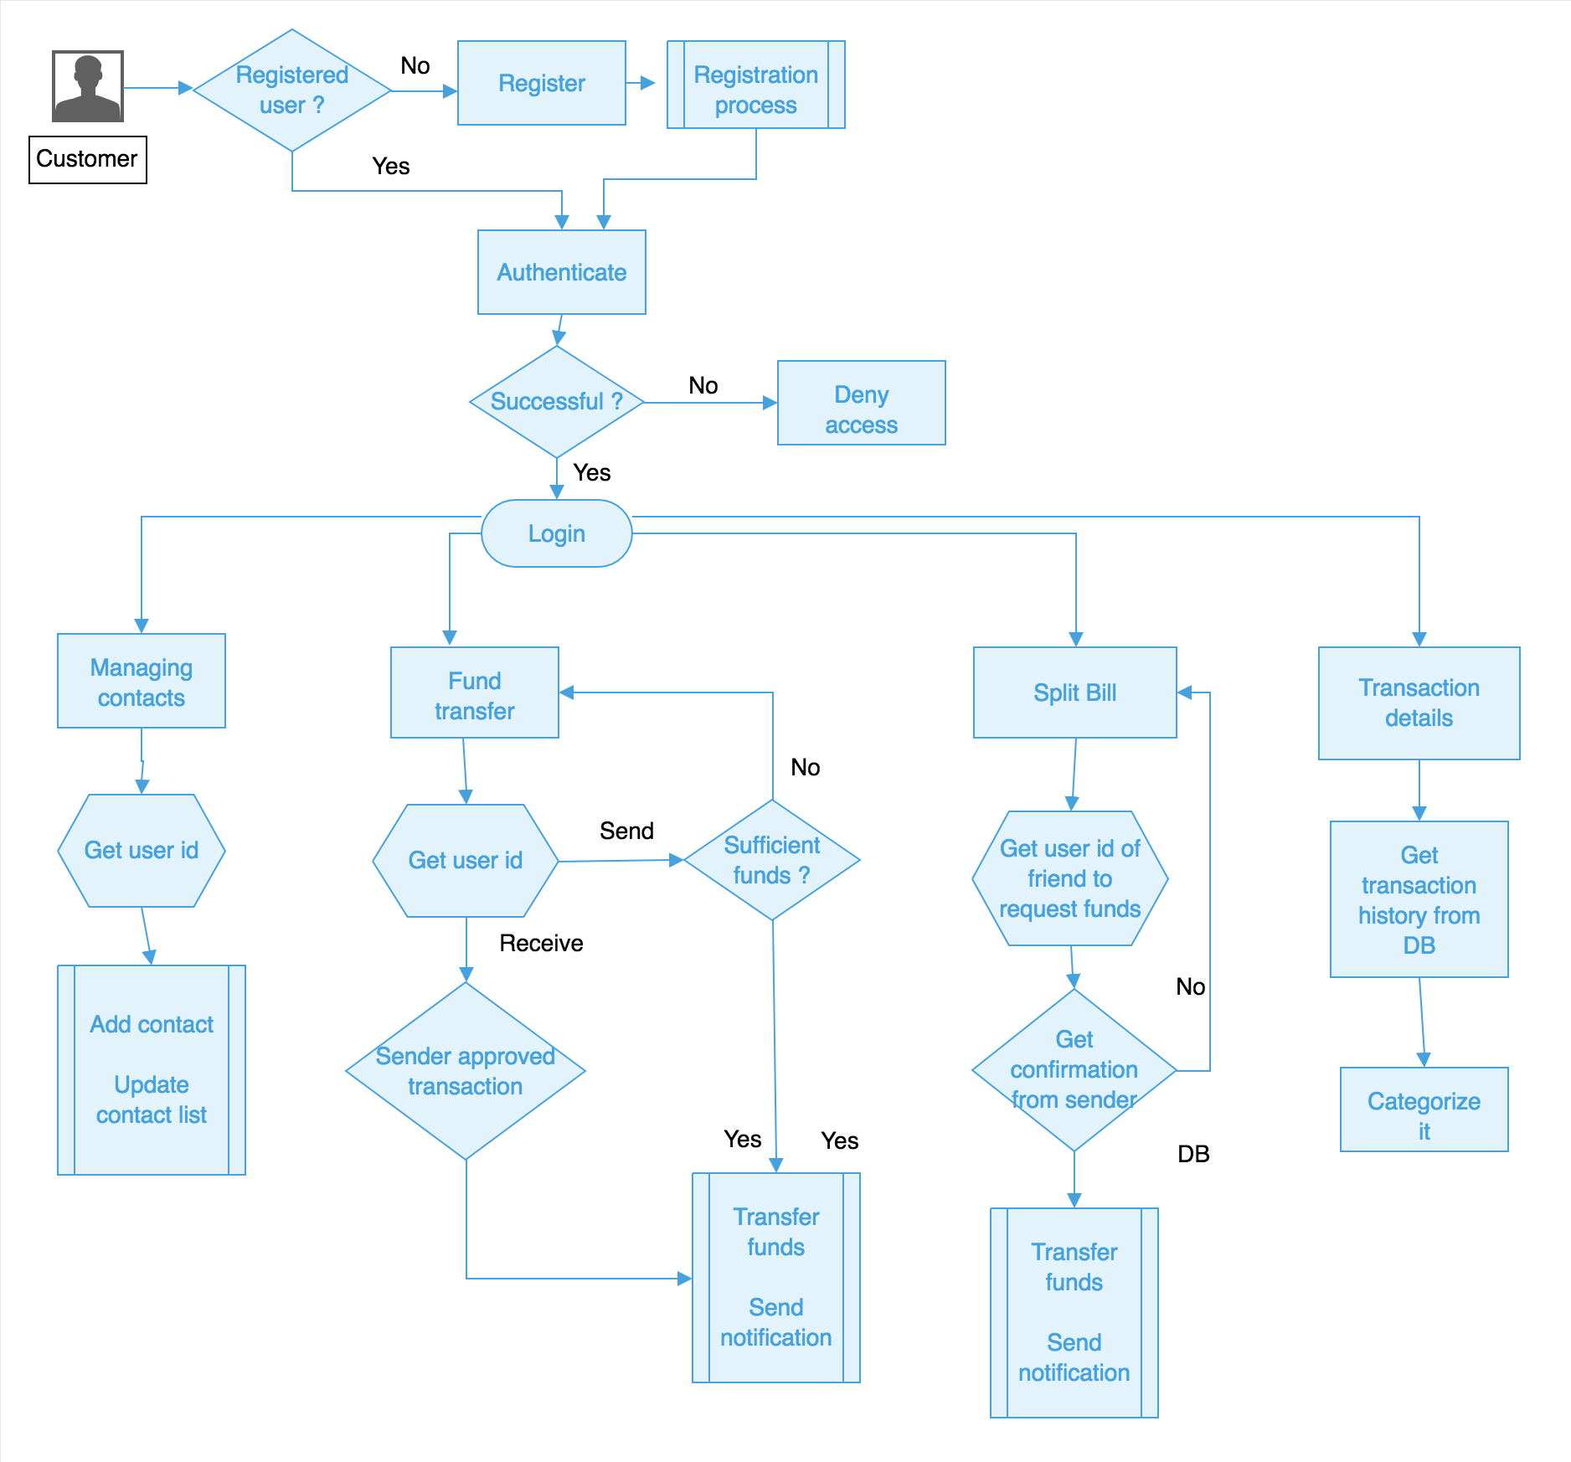
Application Flow

Slide 5
API’S FOR THE PROJECT
User Authentication API: The Authentication API enables you to manage all aspects of user identity when you use Auth0. It offers endpoints so your users can log in, sign up, log out, access APIs, and more. The API supports various identity protocols, like OpenID Connect , OAuth 2.0, and SAML
Wallet API :It is an API solution that allows basic wallet functionalities such as performing a simple token transfer, as well as executing more complex contract calls, while at the same time allowing you to take complete control over the UI and UX
Transaction API:An API transaction is very similar to a “transaction” except for how the transaction is initiated. An API transaction is initiated through an API call on your website or application. With an API transaction, the transaction is often initiated by the end user/participant via your site or application.
Payment Gateway Integration API :Payment gateway API refers to the technical interface that enables software developers to integrate payment gateway services into their applications or websites. Payment gateway integration, on the other hand, is the process of connecting a website or application to a payment gateway using that API

Slide 6
Bank Account/API Integration : API integration is revolutionizing cash application processes by enabling businesses to receive real-time payment information from banks. With API integration from companies like HighRadius, businesses can streamline their cash application processes, reduce costs, and enhance security
Transaction Categorization API :With our transaction categorization and enrichment API, you can categorize credit card and account transactions in the most granular and accurate way. Enrich transactions with all the information your users expect in their bank or fintech app
Notifications API :The Notification interface of the Notifications API is used to configure and display desktop notifications to the user. These notifications' appearance and specific functionality vary across platforms but generally they provide a way to asynchronously provide information to the user
Security and Fraud Prevention API :Fraud Prevention APIs help companies mitigate risk in real-time by preventing fraud such as detecting fake accounts, preventing chargebacks, bad users, account takeover (ATO), bots, and similar abuse

Slide 7
Profile API :The Profile API can be used to query identities, user attributes, audience memberships, and other data available on an mParticle User Profile, anywhere you can make an HTTP request.
Currency Conversion API:Currency conversion APIs collect regular currency updates from tens of thousands of data sources, including international banks, investment firms, financial suppliers, and other public sources. It entails current, reliable, and past data that can span months or years
QR Code Generation and Scanning API:Scan or read QR codes via the Internet. With API, you can develop your QR code. Create custom QR codes with various colors, print formats, etc. Offers encrypted communication via HTTPS (SSL/TLS)

Slide 8
